Slide 1


Slide 2
Agenda
Java Installation
Eclipse IDE Installation
Variables
Data Types
Operators
Conditional Statements
Loops
break
Continue
JAVA TRAINING www.busyqa.com/bigdata |www.busyqa.com/online-automation

Slide 3
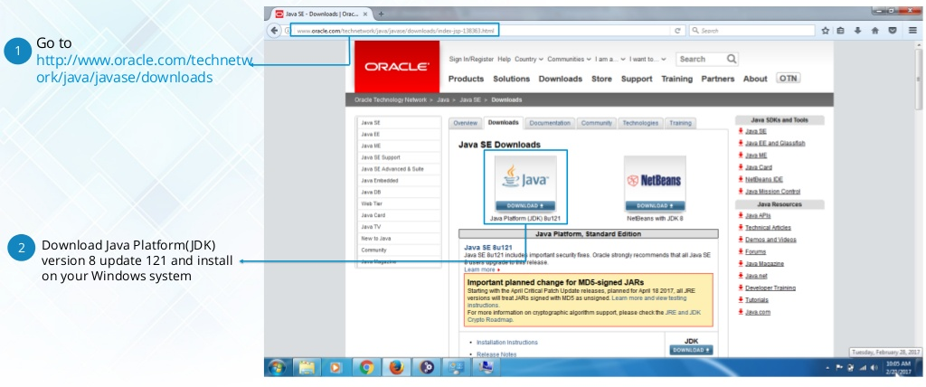
Java Installation
Notes:
` https://www.edureka.co/java-j2ee-soa-trainingEDUREKA JAVA CERTIFICATION TRAINING Java Installation Go to http://www.oracle.com/technetw ork/java/javase/downloads 1 Download Java Platform(JDK) version 8 update 121 and install on your Windows system 2

Slide 4


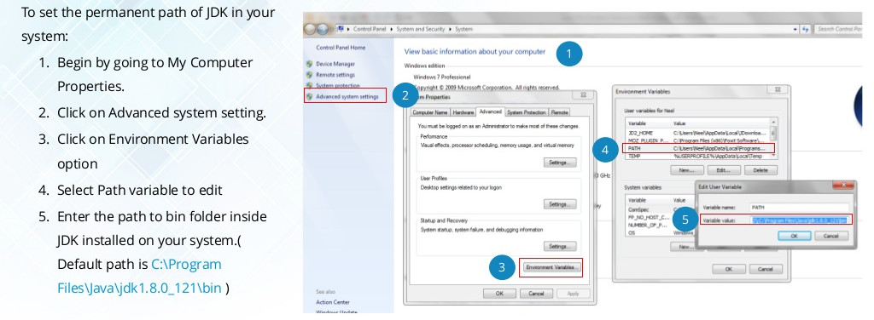
Java Installation
Notes:
` https://www.edureka.co/java-j2ee-soa-trainingEDUREKA JAVA CERTIFICATION TRAINING Java Installation To set the permanent path of JDK in your system: 1. Begin by going to My Computer Properties. 2. Click on Advanced system setting. 3. Click on Environment Variables option 4. Select Path variable to edit 5. Enter the path to bin folder inside JDK installed on your system.( Default path is C:Program FilesJavajdk1.8.0_121bin ) 1 2 3 4 5

Slide 5
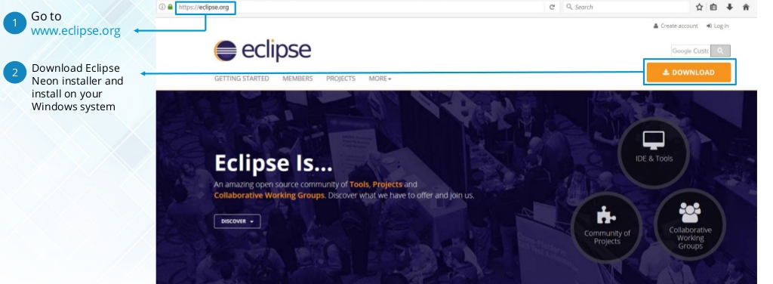
Eclipse Installation
Notes:
` https://www.edureka.co/java-j2ee-soa-trainingEDUREKA JAVA CERTIFICATION TRAINING Go to www.eclipse.org Download Eclipse Neon installer and install on your Windows system 1 2 Eclipse IDE Installation

Slide 6
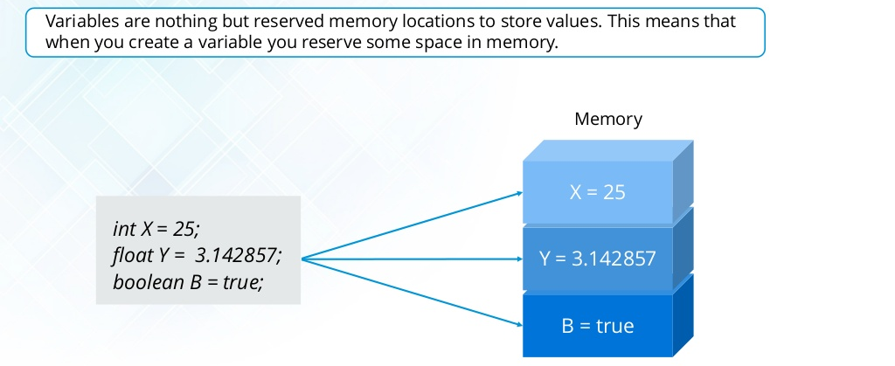
Variable
Notes:
` https://www.edureka.co/java-j2ee-soa-trainingEDUREKA JAVA CERTIFICATION TRAINING Variable Variables are nothing but reserved memory locations to store values. This means that when you create a variable you reserve some space in memory. int X = 25; float Y = 3.142857; boolean B = true; B = true Y = 3.142857 X = 25 Memory

Slide 7

Data Types
Notes:
` https://www.edureka.co/java-j2ee-soa-trainingEDUREKA JAVA CERTIFICATION TRAINING Data types A data type, in programming, is a classification that specifies which type of value a variable has and what type of mathematical, relational or logical operations can be applied to it without causing an error. int X = 25; float Y = 3.142857; boolean B = true; B = true Y = 3.142857 X = 25 Memory Integer Float Boolean

Slide 8
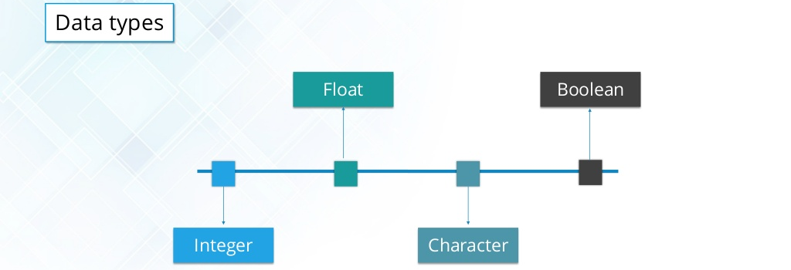
Data Types
Notes:
` https://www.edureka.co/java-j2ee-soa-trainingEDUREKA JAVA CERTIFICATION TRAINING Data types Data types Integer Float Character Boolean

Slide 9
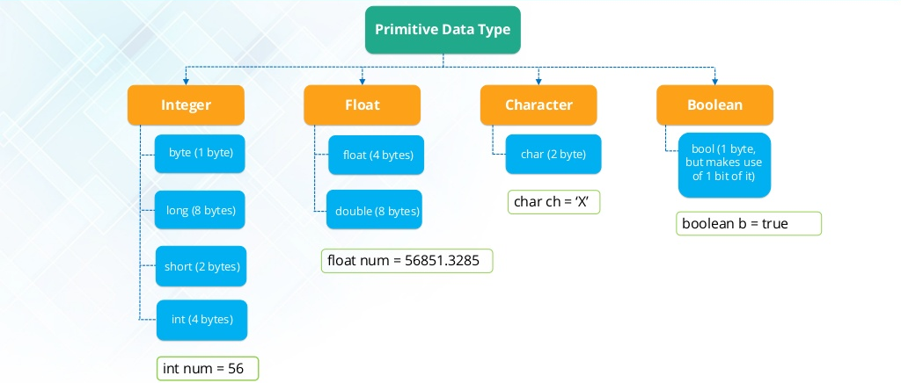
Data types in java
Notes:
` https://www.edureka.co/java-j2ee-soa-trainingEDUREKA JAVA CERTIFICATION TRAINING Data Types in Java Integer BooleanCharacterFloat Primitive Data Type byte (1 byte) long (8 bytes) short (2 bytes) int (4 bytes) float (4 bytes) double (8 bytes) char (2 byte) bool (1 byte, but makes use of 1 bit of it) float num = 56851.3285 char ch = X boolean b = true int num = 56

Slide 10
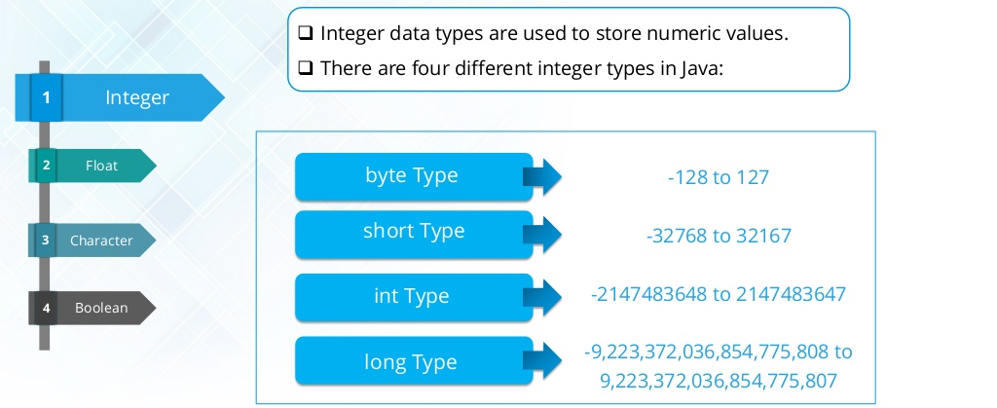
Numeric Data type
Notes:
` https://www.edureka.co/java-j2ee-soa-trainingEDUREKA JAVA CERTIFICATION TRAINING Character Boolean Integer1 3 4 Float32 Numeric Data type ï± Integer data types are used to store numeric values. ï± There are four different integer types in Java: -128 to 127 -32768 to 32167 -2147483648 to 2147483647 -9,223,372,036,854,775,808 to 9,223,372,036,854,775,807 byte Type short Type int Type long Type

Slide 11
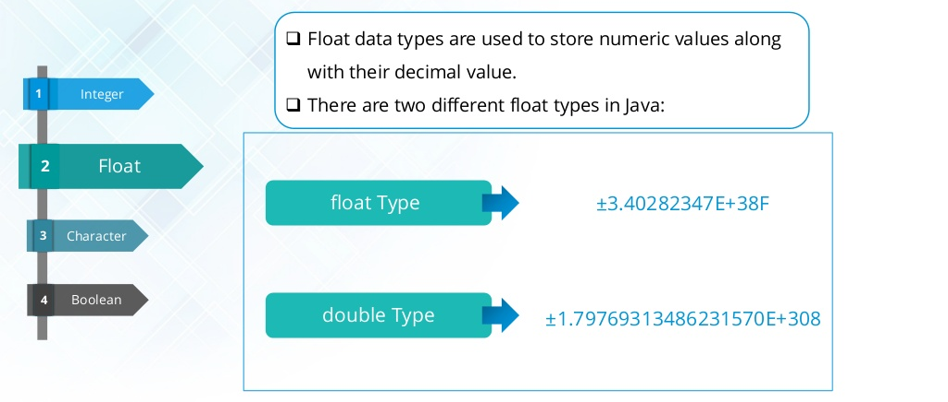
Float Data type
Notes:
` https://www.edureka.co/java-j2ee-soa-trainingEDUREKA JAVA CERTIFICATION TRAINING Character Boolean Integer1 3 4 Float3 2 Float Data type ï± Float data types are used to store numeric values along with their decimal value. ï± There are two different float types in Java: float Type double Type Â±3.40282347E+38F Â±1.79769313486231570E+308

Slide 12
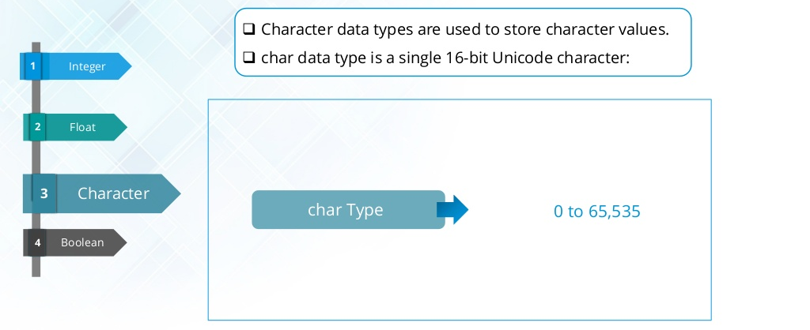
Character Data type
Notes:
` https://www.edureka.co/java-j2ee-soa-trainingEDUREKA JAVA CERTIFICATION TRAINING Boolean Integer1 Character3 4 Float32 Character Data type ï± Character data types are used to store character values. ï± char data type is a single 16-bit Unicode character: char Type 0 to 65,535

Slide 13
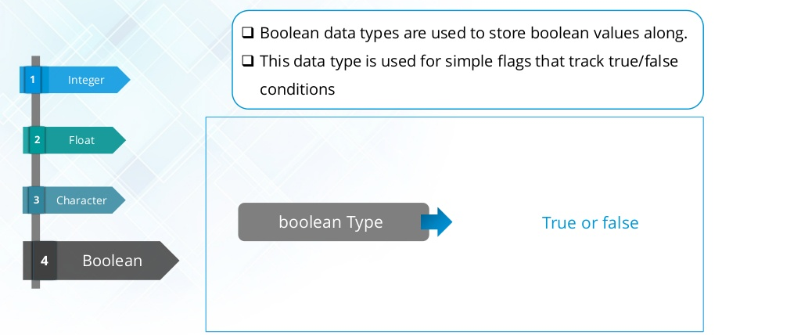
Boolean Data type
Notes:
` https://www.edureka.co/java-j2ee-soa-trainingEDUREKA JAVA CERTIFICATION TRAINING Character Integer1 3 Boolean4 Float32 Boolean Data type boolean Type True or false ï± Boolean data types are used to store boolean values along. ï± This data type is used for simple flags that track true/false conditions

Slide 14
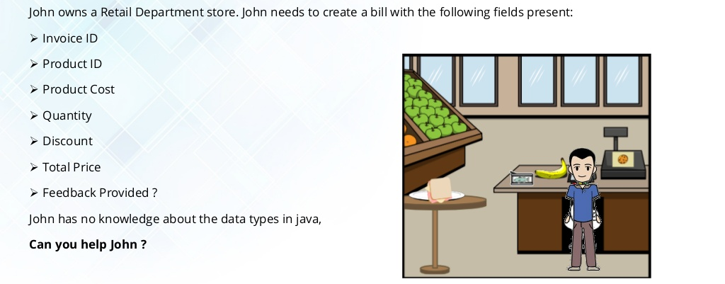
Data types in java
Notes:
` https://www.edureka.co/java-j2ee-soa-trainingEDUREKA JAVA CERTIFICATION TRAINING John owns a Retail Department store. John needs to create a bill with the following fields present: â¢ Invoice ID â¢ Product ID â¢ Product Cost â¢ Quantity â¢ Discount â¢ Total Price â¢ Feedback Provided ? John has no knowledge about the data types in java, Can you help John ? Data Types in Java

Slide 15
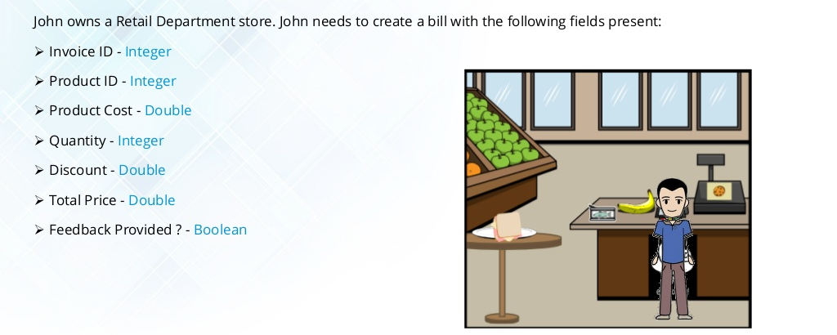
Data types in java
Notes:
` https://www.edureka.co/java-j2ee-soa-trainingEDUREKA JAVA CERTIFICATION TRAINING John owns a Retail Department store. John needs to create a bill with the following fields present: â¢ Invoice ID - Integer â¢ Product ID - Integer â¢ Product Cost - Double â¢ Quantity - Integer â¢ Discount - Double â¢ Total Price - Double â¢ Feedback Provided ? - Boolean Data Types in Java

Slide 16
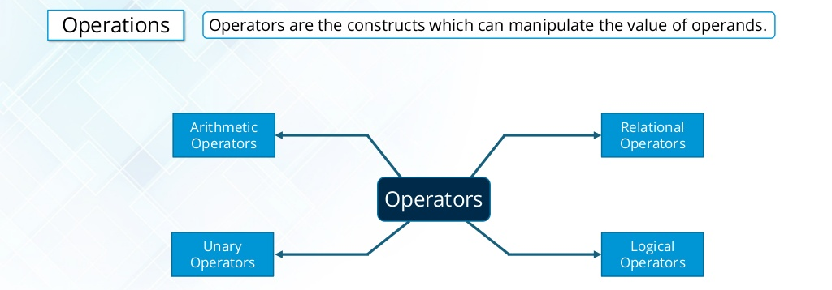
Data Operations
Notes:
` https://www.edureka.co/java-j2ee-soa-trainingEDUREKA JAVA CERTIFICATION TRAINING Data Operations Operators Relational Operators Arithmetic Operators Logical Operators Unary Operators Operations Operators are the constructs which can manipulate the value of operands.

Slide 17
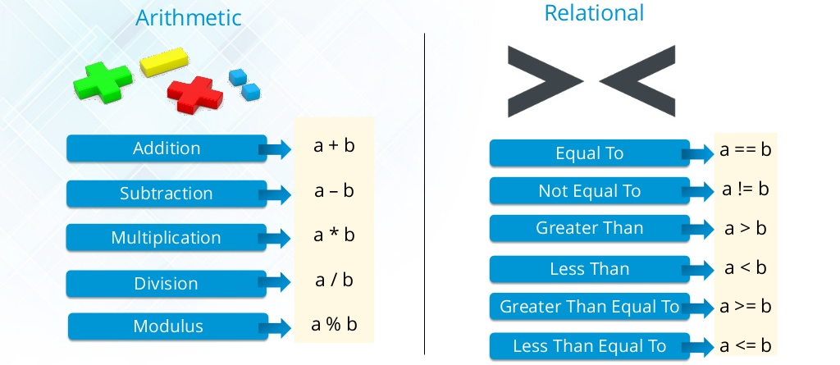
Arithmetic and Relational Operators
Notes:
` https://www.edureka.co/java-j2ee-soa-trainingEDUREKA JAVA CERTIFICATION TRAINING Arithmetic and Relational Operators Arithmetic a + b a  b a * b a / b a % b Addition Multiplication Subtraction Division Modulus a == b a != b a &> b a < b a &>= b a <= b Equal To Greater Than Not Equal To Less Than Greater Than Equal To Less Than Equal To Relational

Slide 18
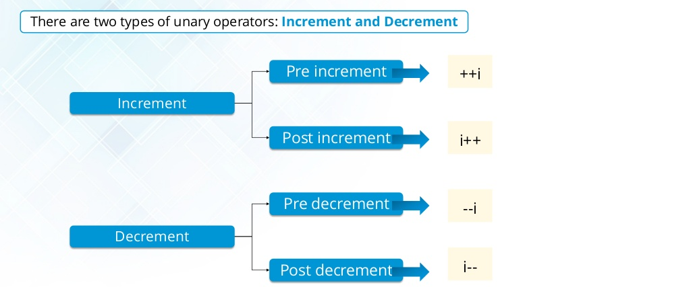
Unary Operators
Notes:
` https://www.edureka.co/java-j2ee-soa-trainingEDUREKA JAVA CERTIFICATION TRAINING Unary Operator There are two types of unary operators: Increment and Decrement Increment Decrement Pre increment Post increment Pre decrement Post decrement ++i i++ --i i--

Slide 19
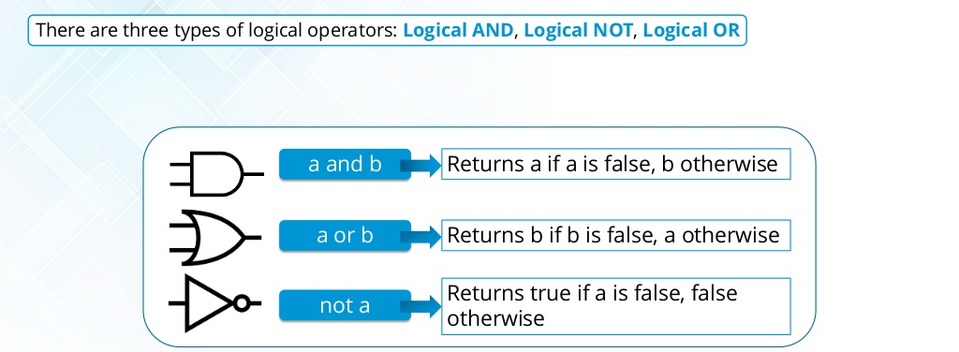
Logical Operators
Notes:
` https://www.edureka.co/java-j2ee-soa-trainingEDUREKA JAVA CERTIFICATION TRAINING Logical Operator There are three types of logical operators: Logical AND, Logical NOT, Logical OR a and b a or b Returns a if a is false, b otherwise Returns b if b is false, a otherwise not a Returns true if a is false, false otherwise

Slide 20
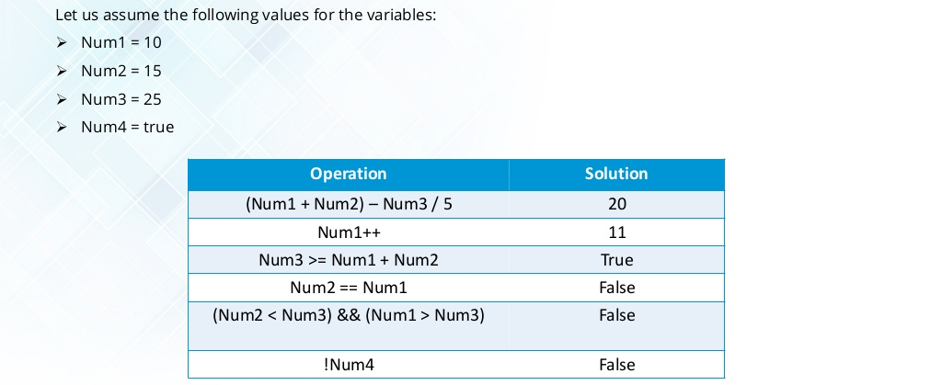
Data Operations
Notes:
` https://www.edureka.co/java-j2ee-soa-trainingEDUREKA JAVA CERTIFICATION TRAINING Data Operations in Java Operation Solution (Num1 + Num2)  Num3 / 5 20 Num1++ 11 Num3 &>= Num1 + Num2 True Num2 == Num1 False (Num2 < Num3) && (Num1 &> Num3) False !Num4 False Let us assume the following values for the variables: â¢ Num1 = 10 â¢ Num2 = 15 â¢ Num3 = 25 â¢ Num4 = true

Slide 21
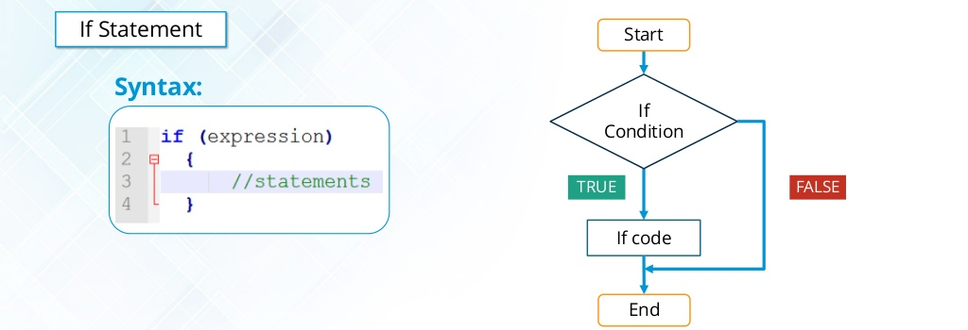
Conditional statements
Notes:
` https://www.edureka.co/java-j2ee-soa-trainingEDUREKA JAVA CERTIFICATION TRAINING Conditional Statements If Statement If code End Start If Condition FALSETRUE Syntax:

Slide 22
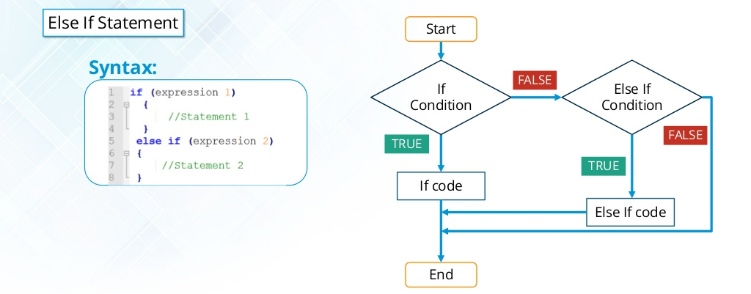
Conditional statements
Notes:
` https://www.edureka.co/java-j2ee-soa-trainingEDUREKA JAVA CERTIFICATION TRAINING Conditional Statements Else If Statement If code End Start If Condition FALSE TRUE FALSE Else If Condition TRUE Else If code Syntax:

Slide 23
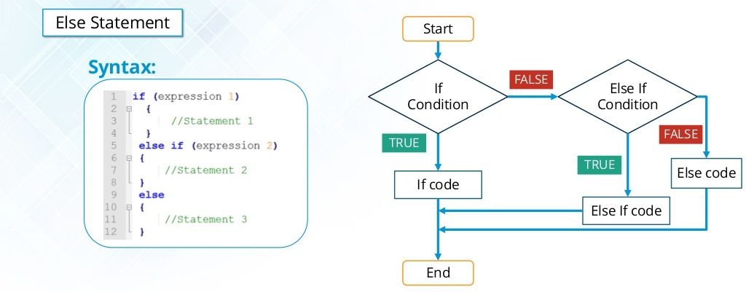
Conditional statements
Notes:
` https://www.edureka.co/java-j2ee-soa-trainingEDUREKA JAVA CERTIFICATION TRAINING Conditional Statements Else Statement Syntax: If code End Start If Condition FALSE TRUE FALSE Else If Condition TRUE Else If code Else code

Slide 24
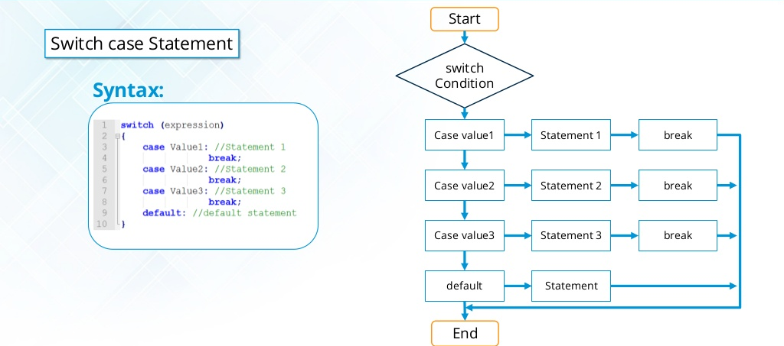
Conditional statements
Notes:
` https://www.edureka.co/java-j2ee-soa-trainingEDUREKA JAVA CERTIFICATION TRAINING Conditional Statements Switch case Statement Syntax: Start switch Condition Case value1 Statement 1 break Case value2 Statement 2 break Case value3 Statement 3 break default Statement End

Slide 25
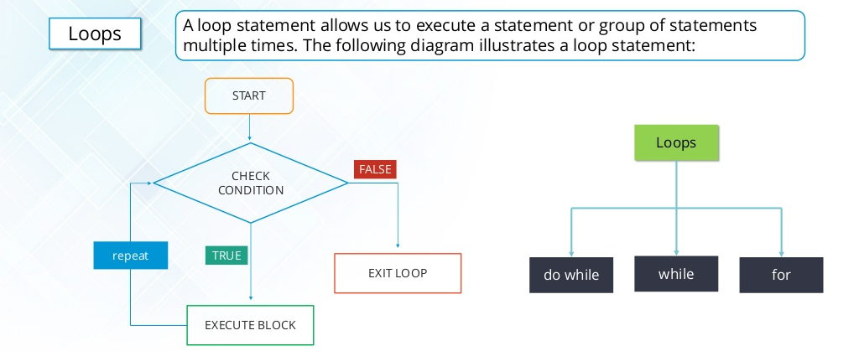
Loops
Notes:
` https://www.edureka.co/java-j2ee-soa-trainingEDUREKA JAVA CERTIFICATION TRAINING Loops in Java A loop statement allows us to execute a statement or group of statements multiple times. The following diagram illustrates a loop statement: Loops Loops forwhiledo while CHECK CONDITION EXECUTE BLOCK START EXIT LOOP FALSE TRUErepeat

Slide 26
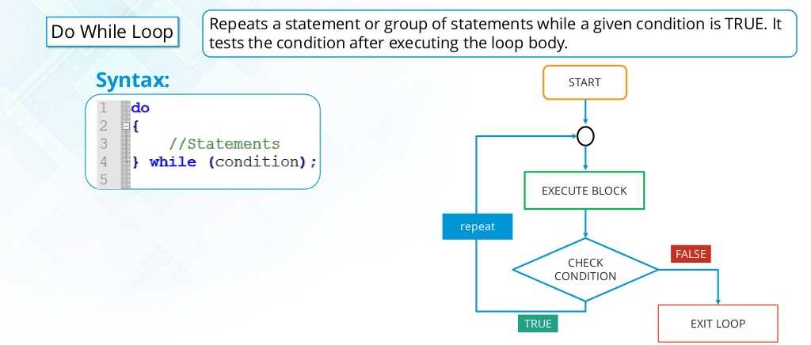
Do While loop
Notes:
` https://www.edureka.co/java-j2ee-soa-trainingEDUREKA JAVA CERTIFICATION TRAINING Do While Loop Do While Loop Repeats a statement or group of statements while a given condition is TRUE. It tests the condition after executing the loop body. Syntax: CHECK CONDITION EXECUTE BLOCK START EXIT LOOP FALSE TRUE repeat

Slide 27
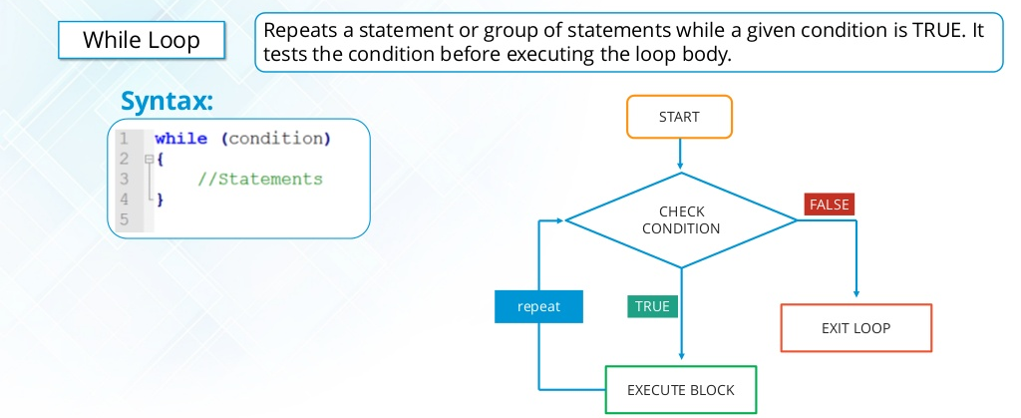
While loop
Notes:
` https://www.edureka.co/java-j2ee-soa-trainingEDUREKA JAVA CERTIFICATION TRAINING While Loop While Loop Repeats a statement or group of statements while a given condition is TRUE. It tests the condition before executing the loop body. Syntax: CHECK CONDITION EXECUTE BLOCK START repeat EXIT LOOP FALSE TRUE

Slide 28
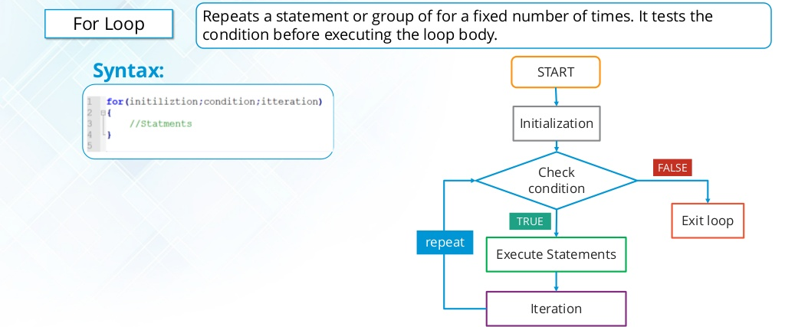
For loop
Notes:
` https://www.edureka.co/java-j2ee-soa-trainingEDUREKA JAVA CERTIFICATION TRAINING For Loop For Loop Repeats a statement or group of for a fixed number of times. It tests the condition before executing the loop body. Syntax: Check condition Initialization START Iteration Execute Statements Exit loop FALSE TRUE repeat

Slide 29
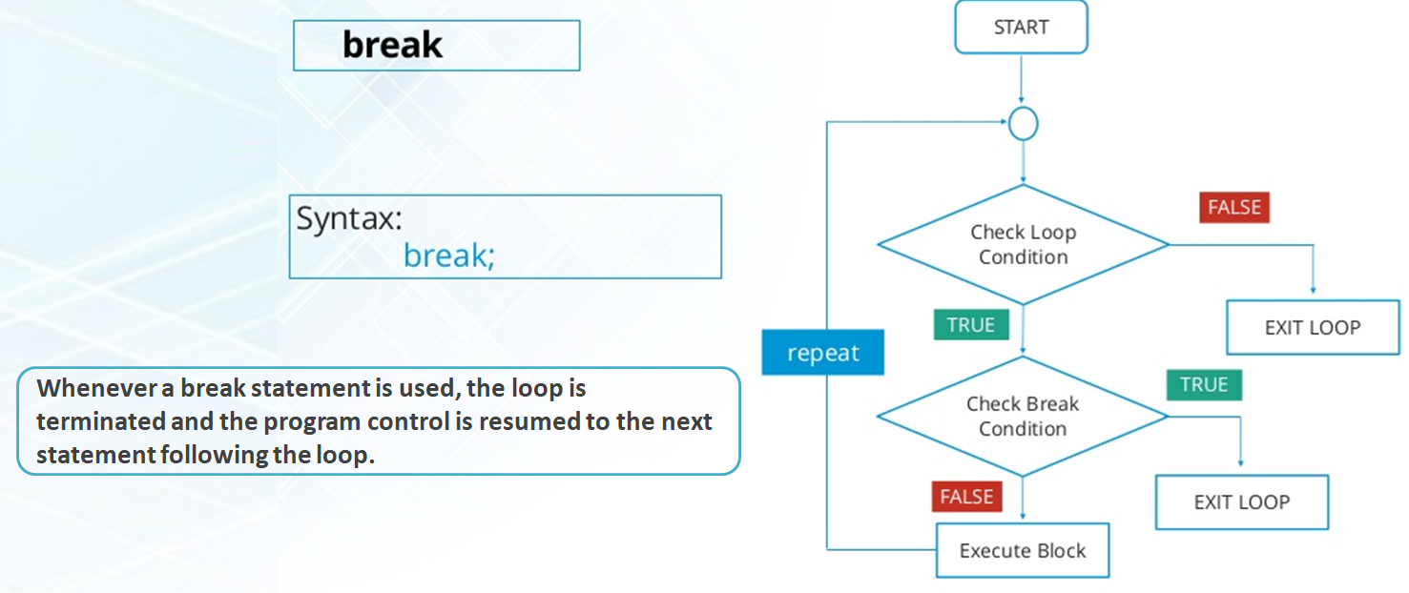

break
Notes:
` https://www.edureka.co/java-j2ee-soa-trainingEDUREKA JAVA CERTIFICATION TRAINING Selection Statements Iteration Statements Jump Statements Control Statement 6. break Syntax: break; Check Loop Condition START repeat EXIT LOOP Check Break Condition EXIT LOOP Execute Block FALSE TRUE TRUE FALSE Control Statement

Slide 30
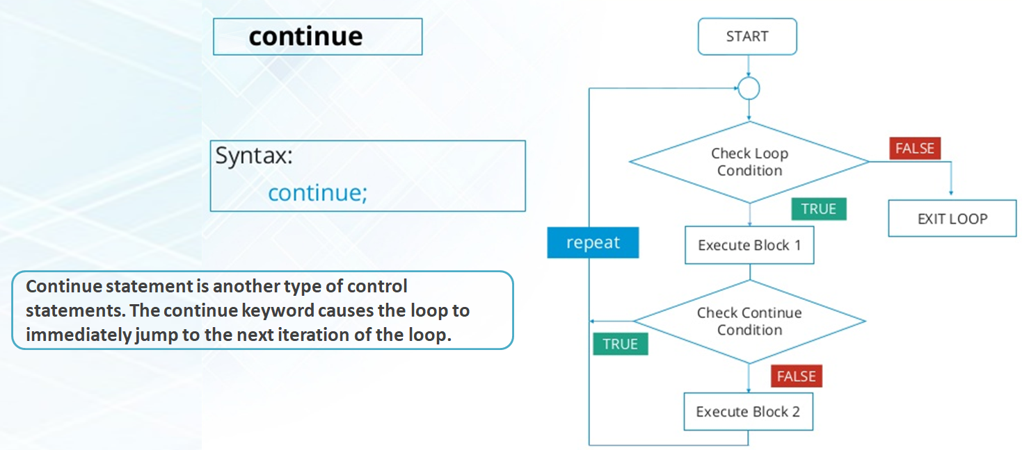
Continue
Notes:
` https://www.edureka.co/java-j2ee-soa-trainingEDUREKA JAVA CERTIFICATION TRAINING Selection Statements Iteration Statements Jump Statements Control Statement Check Loop Condition START repeat EXIT LOOP Check Continue Condition Execute Block 2 7. continue TRUE FALSE FALSE TRUE Syntax: continue; Control Statement Execute Block 1

Slide 31
Agenda
Arrays
Single Dimensional Array
Multi Dimensional Array
Object type
Object Oriented Programming

Slide 32
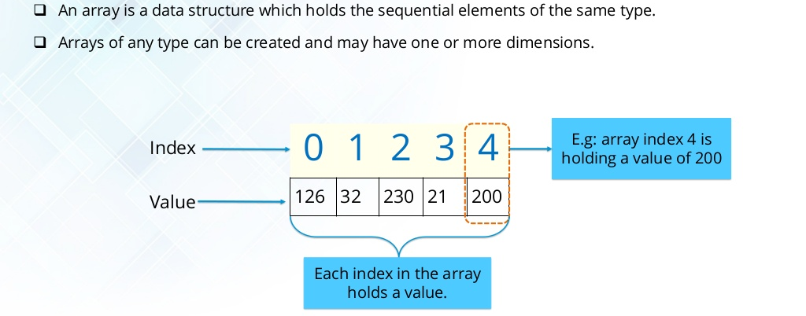
Array in java
Notes:
` https://www.edureka.co/java-j2ee-soa-trainingEDUREKA JAVA CERTIFICATION TRAINING ï± An array is a data structure which holds the sequential elements of the same type. ï± Arrays of any type can be created and may have one or more dimensions. Array In Java 0 1 2 3 4 126 32 230 21 200 Index Value E.g: array index 4 is holding a value of 200 Each index in the array holds a value.

Slide 33
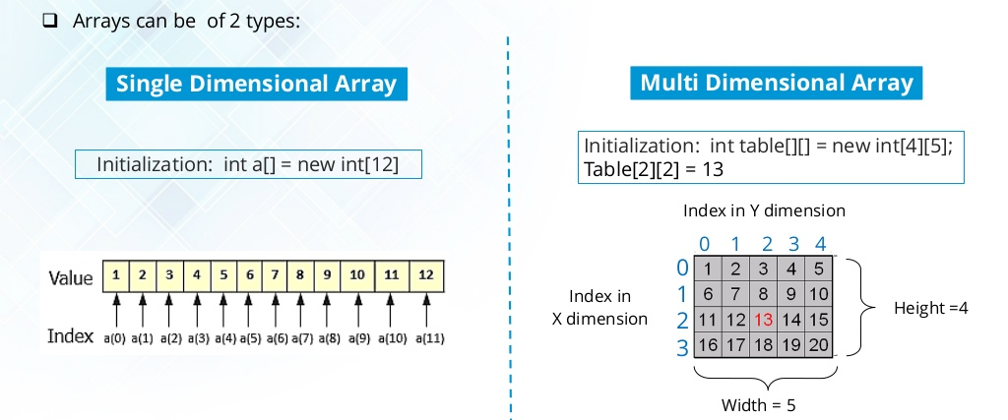
Array in java
Notes:
` https://www.edureka.co/java-j2ee-soa-trainingEDUREKA JAVA CERTIFICATION TRAINING ï± Arrays can be of 2 types: Array In Java Single Dimensional Array Initialization: int a[] = new int[12] Initialization: int table[][] = new int[4][5]; Table[2][2] = 13 Multi Dimensional Array 0 1 2 3 4 0 1 2 3 Width = 5 Height =4 Index in Y dimension Index in X dimension

Slide 34
Object type array
Object is a class in Java which we can use as type for a variable or an array.
Object x; → x holds Any type.
Object x[]=new Object[n]; → x holds Any type values.

Slide 35
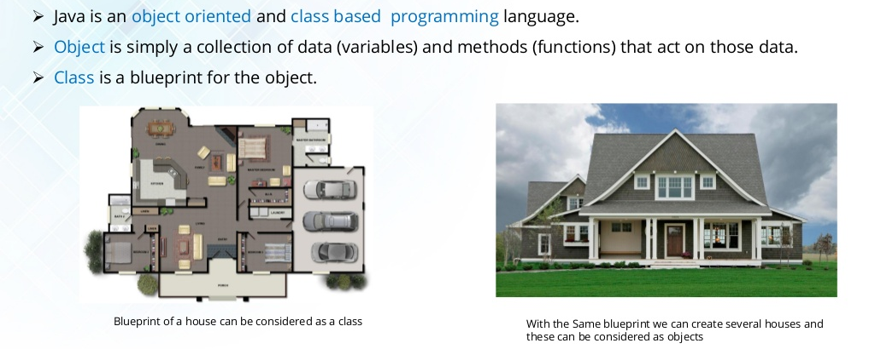
Class & Object
Notes:
` https://www.edureka.co/java-j2ee-soa-trainingEDUREKA JAVA CERTIFICATION TRAINING Blueprint of a house can be considered as a class With the Same blueprint we can create several houses and these can be considered as objects Class and Objects â¢ Java is an object oriented and class based programming language. â¢ Object is simply a collection of data (variables) and methods (functions) that act on those data. â¢ Class is a blueprint for the object.

Slide 36
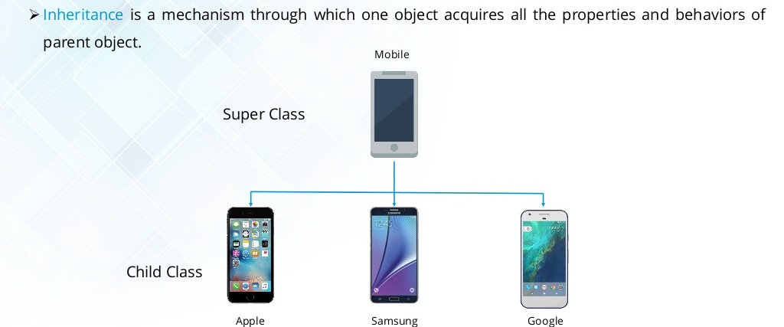
Inheritance
Notes:
` https://www.edureka.co/java-j2ee-soa-trainingEDUREKA JAVA CERTIFICATION TRAINING Super Class Child Class Inheritance â¢ Inheritance is a mechanism through which one object acquires all the properties and behaviors of parent object. Mobile Apple Samsung Google

Slide 37
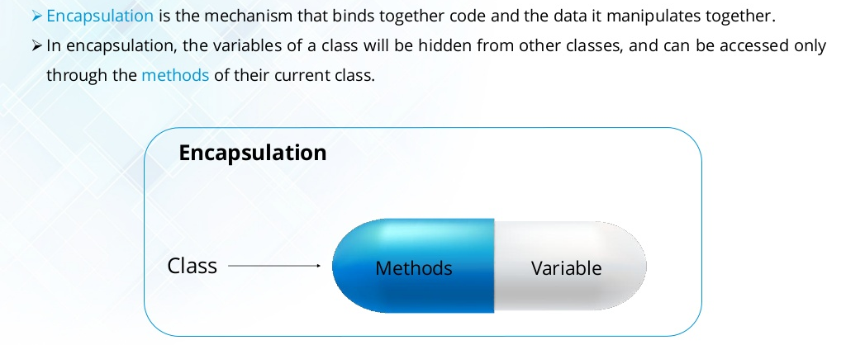
Encapsulation
Notes:
` https://www.edureka.co/java-j2ee-soa-trainingEDUREKA JAVA CERTIFICATION TRAINING Encapsulation Methods Variable Encapsulation Class â¢ Encapsulation is the mechanism that binds together code and the data it manipulates together. â¢ In encapsulation, the variables of a class will be hidden from other classes, and can be accessed only through the methods of their current class.

Slide 38
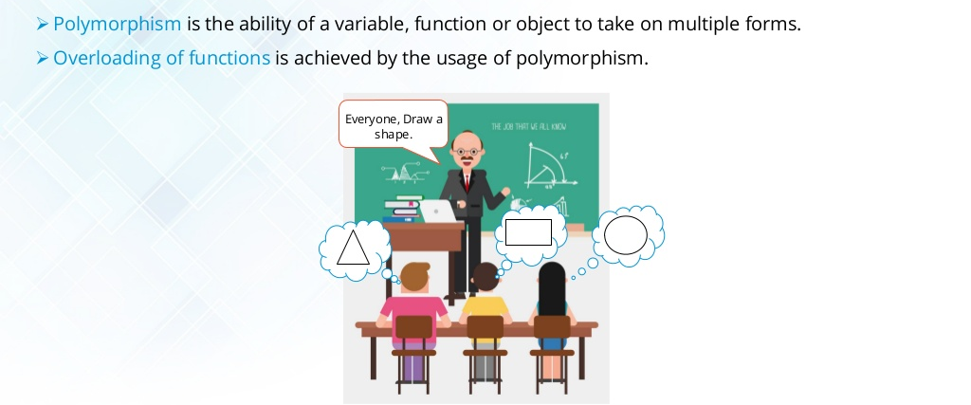
Polymorphism
Notes:
` https://www.edureka.co/java-j2ee-soa-trainingEDUREKA JAVA CERTIFICATION TRAINING Polymorphism â¢ Polymorphism is the ability of a variable, function or object to take on multiple forms. â¢ Overloading of functions is achieved by the usage of polymorphism. Everyone, Draw a shape.

Slide 39
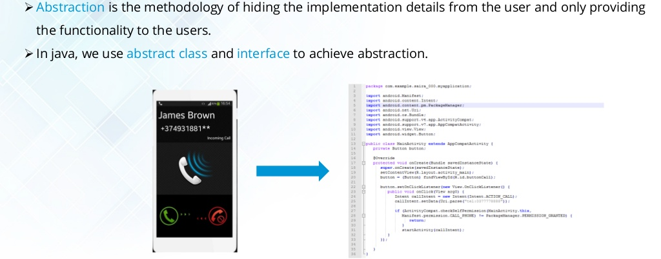
Data Abstraction
Notes:
` https://www.edureka.co/java-j2ee-soa-trainingEDUREKA JAVA CERTIFICATION TRAINING Abstraction â¢ Abstraction is the methodology of hiding the implementation details from the user and only providing the functionality to the users. â¢ In java, we use abstract class and interface to achieve abstraction.

Slide 40
Agenda
Strings
Class & Object
Java Methods
Java Constructor

Slide 41
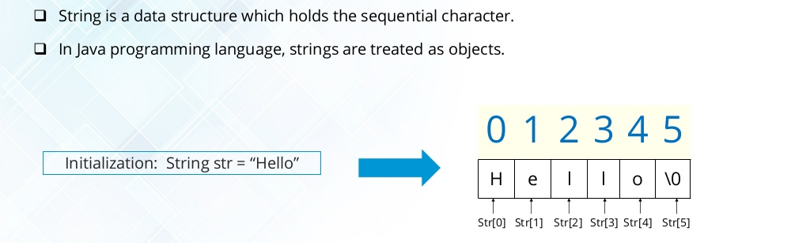
String in java
Notes:
` https://www.edureka.co/java-j2ee-soa-trainingEDUREKA JAVA CERTIFICATION TRAINING ï± String is a data structure which holds the sequential character. ï± In Java programming language, strings are treated as objects. String In Java 0 1 2 3 4 5 H e l l o 0 Initialization: String str = Hello Str[0] Str[1] Str[2] Str[3] Str[4] Str[5]

Slide 42
Operations on Strings
length(): It returns count of total number of characters present in the String.
String s=“Welcome”
s.length()
7
concat() : Combines a specific string at the end of another string and ultimately returns a combined string. It is like appending another string.
String s=“Welcome”
String s1=“ To Java”
s.concat(s1)
Welcome To Java
trim() : The java string trim() method removes the leading and trailing spaces.
String s=“ Welcome ”
s.trim()
Welcome

Slide 43
Operations on Strings
charAt(): Returns a char value at the given index number. The index number starts from 0.
String s=“Welcome”
s.charAt(3)
c
contains() : Searches the sequence of characters in this string. It returns true if sequence of char values are found in this string otherwise returns false.
String s= “Welcome”
s.contains(“Wel”)
True
equals() : Compares the two given strings based on the content of the string. If any character is not matched, it returns false. If all characters are matched, it returns true.
String s=“Welcome”
s.equals(“Welcome”)
True
String s=“Welcome”
s.equals(“welcome”)
False

Slide 44
Operations on Strings
equalsIgnoreCase() : Compares two string on the basis of content but it does not check the case like equals() method. In this method, if the characters match, it returns true else false.
String s=“Welcome”
s.equalsIgnoreCase(“Welcome”)
True
String s=“Welcome”
s.equalsIgnoreCase(“welcome”)
True
replace(): Returns a string, replacing all the old characters or CharSequence to new characters. There are 2 ways to replace methods.
String s=“Welcome”
s.replace(’e’, ’a’)
Walcoma
String s=“Welcome To Java”
s.replace(“Java”, ”Selenium”)
Welcome To Selenium

Slide 45
Operations on Strings
Substring() : Returns substring of a string based on starting index and ending index.
Starting Index
0 | 1 | 2 | 3 | 4 | 5 | 6
W | E | L | C | O | M | E
1 | 2 | 3 | 4 | 5 | 6 | 7
s
Ending Index
String s=“Welcome”
s.substring(1,3)
el
String s=“Welcome”
s.substring(0,4)
Welc
String s=“Welcome”
s.substring(2,4)
lc

Slide 46
Operations on Strings
toLowerCase(): returns the string in lowercase letter.
String s=“WELCOME”
s.toLowerCase()
welcome
toUpperCase(): returns the string in Uppercase letter.
String s=“welcome”
s.toUpperCase()
WELCOME

Slide 47
Class & Object
Object1
class Employee
{
int eid;
String ename;
double sal;
String job;
void display()
{
System.out.println(eid);
System.out.println(ename);
System.out.println(sal);
System.out.println(job);
}
void bonus()
{
System.out.println((sal *10) /100);
}
}
Employee emp1=new Employee();
emp1.eid=1020;
emp1.ename="John";
emp1.sal=80000;
emp1.job="Manager";
emp1.display();
Variables
Object2
Class
Employee emp2=new Employee();
emp2.eid=1021;
emp2.ename="David";
emp2.sal=50000;
emp2.job="Tech Assistant";
emp2.display();
Methods

Slide 48
Class & Object
main() within class
Student.java
class Student{
int id=101; //field or data member or instance variable
String name=“Anil”;
public static void main(String args[]){
Student s1=new Student();//creating an object of Student
System.out.println(s1.id);//accessing member through reference variable System.out.println(s1.name);
}
}

Slide 49
Class & Object
main() outside class
In real time development, we create classes and use it from another class. It is a better approach than previous one.
We can have multiple classes in different java files or single java file.
Student1.java
Student.java
Class Student1{
public static void main(String args[])
{
Student s1=new Student();
System.out.println(s1.id);
System.out.println(s1.name);
}
}
class Student
{
int id=101;
String name=“Anil”;
}

Slide 50
Class & Object
3 ways to initialize object variables in java.
By reference variable
By method
By constructor

Slide 51
Class & Object
Initialization through reference variable
Student2.java
Student.java
class Student{
int id;
String name;
}
Class Student2{
public static void main(String args[]){
Student s=new Student();
s.id=101;
s.name=“Anil”;
System.out.println(s.id+" "+s.name);
}
}

Slide 52
Class & Object
Initialization through method
Student.java
Student3.java
class Student {
int id;
String name;
void insertRecord(int i, String n)
{
id=i;
name=n;
}
void displayInformation()
{
System.out.println(id+" "+name);
}
}
Class Student3{
public static void main(String args[])
{
Student s1=new Student();
Student s2=new Student();
s1.insertRecord(111,"Karan");
s2.insertRecord(222,"Aryan");
s1.displayInformation();
s2.displayInformation();
}
}

Slide 53
Class & Object
Initialization through constructor.
Student.java
Student4.java
class Student{
int id;
String name;
void Student(int i, String n)
{
id=r;
name=n;
}
void displayInformation()
{
System.out.println(id+" "+name);
}
}
class TestStudent4
{
public static void main(String args[])
{
Student s1=new Student(111,”Kiran”);
Student s2=new Student(222,”arya”);
s1.displayInformation();
s2.displayInformation();
}
}

Slide 54
Java Methods
A method is a set of code which is referred to by name and can be called (invoked) at any point in a program simply by utilizing the method's name.
A method as a subprogram that acts on data and often returns a value.
Each method has its own name.
 | Parameter/s | Returned Value
Case1 | ❒ | ❒
Case2 | ❒ | 
Case3 |  | ❒
Case4 |  | 

Slide 55
Java Constructor
Constructor in java is a special type of method that is used to initialize the object.
Java constructor is invoked at the time of object creation.
Rules for creating java constructor:
Constructor name must be same as its class name.
Constructor must have no explicit return type.
There are 2 Types of Constructors.
Constructor
Default
Parameterized

Slide 56
Method V/s Constructor
Method name can be anything.
Method can return a value.
Need to call method explicitly.
Method
Constructor name must be same as class name.
Constructor doesn't return a value.
Automatically invoked at the time of object creation.
Constructor

Slide 57
Agenda
Overloading
this keyword
Static variables & static methods
Java Inheritance
Method Overriding
super Keyword
final Keyword

Slide 58
Overloading
Overloading in Java is a concept related to Object Oriented Programming (OOP).
Java supports overloading of methods/constructors and can distinguish them with signatures.
A situation, wherein, in the same class there are two or more methods/constructors with same name, having different functions or different parameters, it is called Overloading.
Following are the conditions for method overloading in Java:
The overloaded function must differ either by the number of arguments or operands or data types.
The same function name is used for various instances of function call.
Method Overloading can be done in two ways:
By changing Arguments’ data types
By changing number of Arguments

Slide 59
Overloading
10, 20
add(int x, int y)
add(int x, int y, int z)
add(double x, double y)
add(double x, double y, double z)
add (int x, double y)
add (double y, int x)
10, 20, 30
10.5, 20.0
10.5, 20.0, 30.5
10, 20.5
20.5, 10

Slide 60
Can we overload java main() method?
Yes, by method overloading. You can have any number of main methods in a class by method overloading. But JVM calls main() method which receives string array as arguments only.
class TestOverloading
{
public static void main(String[] args)
{
System.out.println("main with String[]");
}
public static void main(String args)
{
System.out.println("main with String");
}
public static void main()
{
System.out.println("main without args");
}
}

Slide 61
this keyword
The this keyword can be used to refer current class instance variable. If there is ambiguity between the instance variables and parameters, this keyword resolves the problem of ambiguity.
public class Calculator
{
int a, b;
void add(int a, int b)
{
a = a;
b = b;
}
void display() {
System.out.println(a);
System.out.println(b);
}
public static void main(String[] args)
{
Calculator cal = new Calculator();
cal.add(10, 20);
cal.display();
}
}
public class Calculator
{
int a, b;
void add(int a, int b)
{
this.a = a;
this.b = b;
}
void display() {
System.out.println(a);
System.out.println(b);
}
public static void main(String[] args)
{
Calculator cal = new Calculator();
cal.add(10, 20);
cal.display();
}
}
Output:
0
0
Output:
10
20

Slide 62
static
The static keyword in java is used for memory management mainly.
We can apply java static keyword with variables and methods
The static can be:
variable (also known as class variable)
method (also known as class method)
static
variable
method

Slide 63
static
Employee
int empno;
String ename;
int deptno;
void bonus()
emp1
emp2
emp3
int empno=101;
String ename=“John”;
int deptno=10;
void bonus()
int empno=102;
String ename=“David”;
int deptno=10;
void bonus()
int empno=103;
String ename=“Scott”;
int deptno=10;
void bonus()
Every object occupy certain amount of space in memory.
Objects are independent. So if modify a variable value in obj1 , that will not reflect other objects variable values.

Slide 64
static
Employee
int empno;
String ename;
static int deptno=10;
void bonus()
deptno=10
emp1
emp2
emp3
int empno=101;
String ename=“John”;
void bonus()
int empno=102;
String ename=“David”;
void bonus()
int empno=103;
String ename=“Scott”;
void bonus()
emp1.deptno=20
emp2.deptno=30
emp3.deptno=40
static variable is common across all the objects. So if static variable modified, this will effect other objects.

Slide 65
static variables & methods
 | static |  | Non-static
 | Variables | Methods | Variables | Methods
static methods |  |  |  | 
Non-static methods |  |  |  | 
Direct Access
Through Object

Slide 66

Inheritance
In OOP, computer programs are designed in such a way where everything is an object that interact with one another. Inheritance is one such concept where the properties of one class can be inherited by the other.
It helps to reuse the code and establish a relationship between different classes.
In Java, there are two classes:
1. Parent class ( Super or Base class)
2. Child class (Subclass or Derived class )
A class which inherits the properties is known as Child Class
whereas a class whose properties are inherited is known as Parent class.

Slide 67
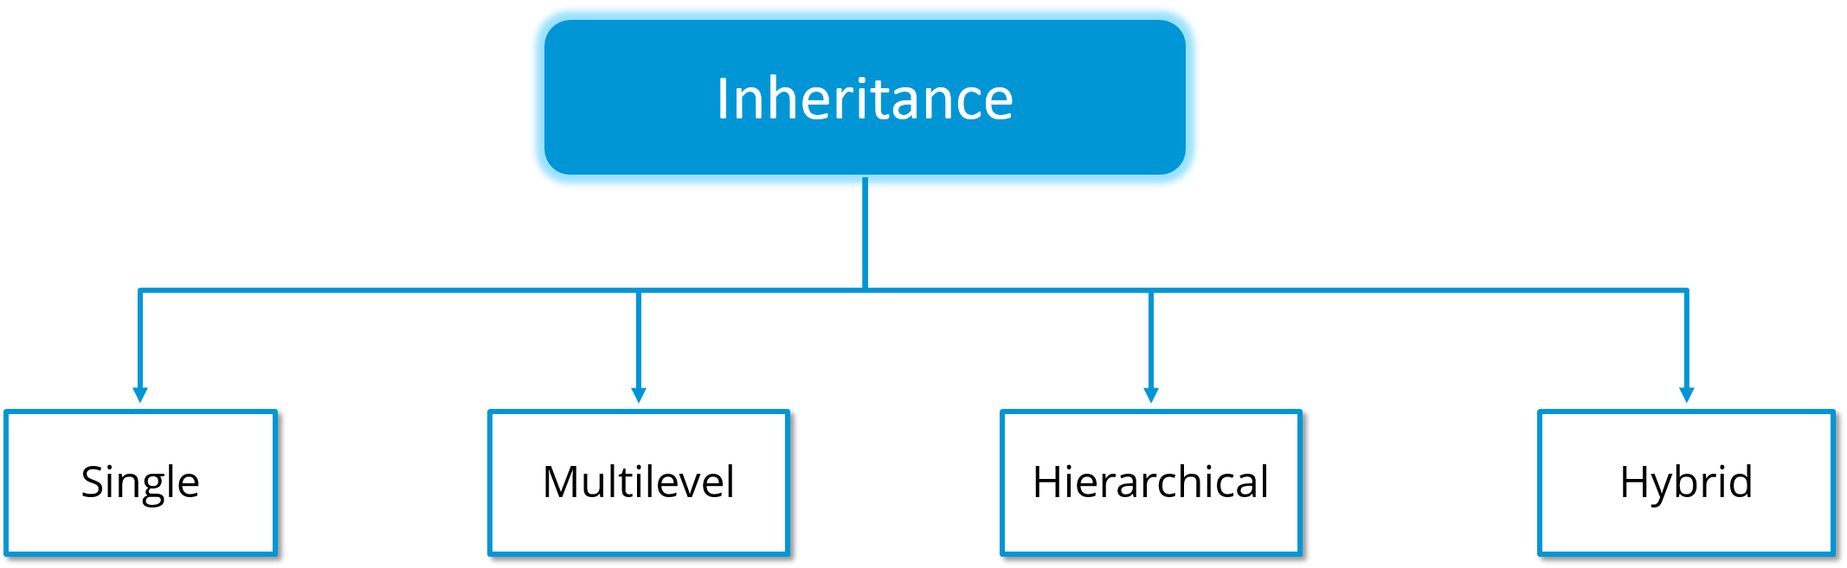
Types of Inheritance
Inheritance is further classified into 4 types.

Slide 68
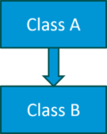
Single Inheritance
In single inheritance, one class inherits the properties of another.
It enables a derived class to inherit the properties and behavior from a single parent class.
Here, Class A is your parent class and Class B is your child class which inherits the properties and behavior of the parent class.
Class A
{
---
}
Class B extends A
{
---
}

Slide 69
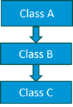
Multilevel Inheritance
When a class is derived from a class which is also derived from another class, i.e. a class having more than one parent class but at different levels, such type of inheritance is called Multilevel Inheritance.
If we talk about the flowchart, class B inherits the properties and behavior of class A and class C inherits the properties of class B. Here A is the parent class for B and class B is the parent class for C. So in this case class C implicitly inherits the properties and methods of class A along with Class B.
Class A
{
---
}
Class B extends A
{
---
}
Class C extends B
{
---
}

Slide 70
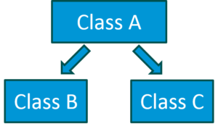
Hierarchical Inheritance
When a class has more than one child classes (sub classes) or in other words, more than one child classes have the same parent class, then such kind of inheritance is known as hierarchical.
If we talk about the flowchart, Class B and C are the child classes which are inheriting from the parent class i.e Class A.
Class A{
---
}
Class B extends A
{
---
}
Class C extends A
{
---
}

Slide 71
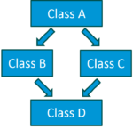
Hybrid Inheritance
Hybrid inheritance is a combination of multiple inheritance and multilevel inheritance.
Since multiple inheritance is not supported in Java as it leads to ambiguity, so this type of inheritance can only be achieved through the use of the interfaces.
If we talk about the flowchart, class A is a parent class for class B and C, whereas Class B and C are the parent class of D which is the only child class of B and C.

Slide 72
Method Overriding
If subclass (child class) has the same method as declared in the parent class, it is known as method overriding in java.
Rules for Java Method Overriding
method must have same name as in the parent class
method must have same parameter as in the parent class.

Slide 73
super keyword
The super keyword in java is a reference variable which is used to refer immediate parent class object.
Usage of java super Keyword
super can be used to refer immediate parent class instance variable.
super can be used to invoke immediate parent class method.
super() can be used to invoke immediate parent class constructor.

Slide 74
super is used to refer immediate parent class instance variable.
super keyword
class Animal
{
String color="white";
}
class Dog extends Animal
{
String color="black";
void printColor()
{
System.out.println(color);//prints color of Dog class
System.out.println(super.color);//prints color of Animal class
}
}
class TestSuper1
{
public static void main(String args[])
{
Dog d=new Dog();
d.printColor();
}
}

Slide 75
super can be used to invoke parent class method.
super keyword
class Animal
{
void eat()
{
System.out.println("eating...");
}
}
class Dog extends Animal
{
void eat()
{
System.out.println("eating bread...");
}
void work()
{
super.eat();
eat();
}
}
class TestSuper2
{
public static void main(String args[])
{
Dog d=new Dog();
d.work();
}
}

Slide 76
super is used to invoke parent class constructor.
super keyword
class Animal
{
Animal()
{
System.out.println("animal is created");
}
}
class Dog extends Animal
{
Dog()
{
super();
System.out.println("dog is created");
}
}
class TestSuper3
{
public static void main(String args[])
{
Dog d=new Dog();
}
}

Slide 77
final Keyword
The final keyword in java is used to restrict the user. The java final keyword can be used for variables, methods and classes.
variable
method
class

Slide 78
Java final variable
If you make any variable as final, you cannot change the value of final variable(It will be constant).
class Bike9
{
final int speedlimit=90;//final variable
void run()
{
speedlimit=400;
}
public static void main(String args[])
{
Bike9 obj=new Bike9();
obj.run();
}
}//end of class
Output:Compile Time Error

Slide 79
Java final method
If you make any method as final, you cannot override it.
class Bike
{
final void run()
{
System.out.println("running");
}
}
class Honda extends Bike
{
void run()
{
System.out.println("running safely with 100kmph");
}
public static void main(String args[])
{
Honda honda= new Honda();
honda.run();
}
}
Output:Compile Time Error

Slide 80
Java final class
If you make any class as final, you cannot extend it.
final class Bike
{
}
class Honda1 extends Bike
{
void run()
{
System.out.println("running safely with 100kmph");
}
public static void main(String args[])
{
Honda1 honda= new Honda();
honda.run();
}
}
Output:Compile Time Error

Slide 81
Agenda
Java Interfaces
Java Packages
Access modifier’s
Exception Handling

Slide 82
Java Interface
An interface in java is a blueprint of a class.
Interface contains final and static variables.
Interface contains abstract methods.
An abstract method is a method contains definition but not body.
Methods in interface are public by default.
Interface supports the functionality of multiple inheritance.
We can define interface with interface keyword.
A class extends another class, an interface extends another interface but a class implements an interface.
We can create Object reference for Interface but we cannot instantiate interface.
class
interface
interface
extends
implements
extends
class
class
interface

Slide 83
Java Interface
class
interface
interface
extends
implements
extends
class
class
interface
class A
{
//Variables
//Methods
}
class B extends A
{
//Variables
//Methods
}
interface I
{
//abstract methods
//final static variables
}
class B implements I
{
//Method implementation;
}
interface I1
{
//abstract methods
//final static variables
}
Interface I2 extends I1
{
//abstract methods
//final static variables
}
class B implements I2
{
//Methods implementation;
}

Slide 84
Multiple Inheritance in Java by Interface
interface
interface
interface
interface
extends
implements
interface
class
implements
class
class A implements I1, I2
{
//Implement all the methods from I1 & I2
}
interface I extends I1, I2
{
//final static variables
//abstract methods
}
class A implements I
{
//Implement all the methods from I
}

Slide 85
Java Packages
A java package is a group of similar types of classes, interfaces and sub-packages.
Package in java can be categorized in two forms.
Built-in package
User-defined package
There are many built-in packages such as java, lang, awt, javax, swing, net, io, util, sql etc.

Slide 86
Access package from another package
There are two ways to access the package from outside the package.
import package.*;
import package.classname;

Slide 87
Access Modifiers in java
The access modifiers in java specifies accessibility (scope) of a data member, method, constructor or class.
There are 4 types of java access modifiers:
private
default
protected
public

Slide 88
private access modifier
The private access modifier is accessible only within class.
class A{
private int data=40;
private void msg(){
System.out.println("Hello java");
}
}
public class Simple{
public static void main(String args[]){
A obj=new A();
System.out.println(obj.data);//Compile Time Error
obj.msg();//Compile Time Error
}
}

Slide 89
default access modifier
If you don't use any modifier, it is treated as default by default. The default modifier is accessible only within package.
//save by B.java
package mypack;
import pack.*;
class B{
public static void main(String args[]){
A obj = new A();//Compile Time Error
obj.msg();//Compile Time Error
}
}
//save by A.java
package pack;
class A{
void msg(){System.out.println("Hello");}
}
* In the above example, the scope of class A and its method msg() is default so it cannot be accessed from outside the package.

Slide 90
protected access modifier
The protected access modifier is accessible within package and outside the package but through inheritance only.
The protected access modifier can be applied on the data member, method and constructor. It can't be applied on the class.
//save by B.java
package mypack;
import pack.*;
class B extends A
{
public static void main(String args[])
{
B obj = new B();
obj.msg();
}
}
//save by A.java
package pack;
public class A
{
protected void msg()
{
System.out.println("Hello");
}
}

Slide 91
public access modifier
The public access modifier is accessible everywhere. It has the widest scope among all other modifiers.
//save by B.java
package mypack;
import pack.*;
class B{
public static void main(String args[])
{
A obj = new A();
obj.msg();
}
}
//save by A.java
package pack;
public class A{
public void msg()
{System.out.println("Hello");
}
}

Slide 92
Access modifiers
Access Modifier | within class | within package | outside package by subclass only | outside package
Private | Y | N | N | N
Default | Y | Y | N | N
Protected | Y | Y | Y | N
Public | Y | Y | Y | Y

Slide 93
Java Exceptions
Exception is an abnormal condition.
In java, exception is an event that disrupts the normal flow of the program.
There are two types of exceptions.
1. Checked Exceptions
2. Un-checked Exceptions
Exception
Checked
Un-Checked

Slide 94
Un Checked Exceptions
Exceptions that are NOT checked by compiler are called Un-Checked Exceptions.
Un checked Exceptions successfully compiled by Java compiler.
At run time it throws exception.
Examples:
ArithmeticException
NullPointerException
NumberFormatException
ArrayIndexOutOfBoundsException

Slide 95
Common Un-Checked exceptions
int a=50/0
ArithmeticException
String s=null;
System.out.println(s.length());
NullPointerException
String s="abc";
int i=Integer.parseInt(s);
NumberFormatException
int a[]=new int[5];
a[10]=50;
ArrayIndexOutOfBoundsException

Slide 96
Checked Exceptions
Exceptions that are checked by compiler are called Checked Exceptions.
If a program contains checked-Exception code is not compiled.
Examples:
InterruptedException
IOException
FileNotFoundException etc.

Slide 97
Common Checked exceptions
Thread.sleep(3000);
InterruptedException
FileReader fr = new FileReader("C:\\Test.txt");
BufferedReader bfr = new BufferedReader(fr);
System.out.println(bfr.readLine());
FileNotException
IOException

Slide 98
Java Exception Handling Keywords
try
catch
finally
throws

Slide 99
Java try..catch block
Java try block is used to enclose the code that might throw an exception.
It must be applied at statement level within the method.
Java try block must be followed by either catch or finally block.
Used for both Un-checked and Checked Exceptions.
Java catch block is used to handle the Exception. It must be used after the try block only.
You can use multiple catch block with a single try.
Syntax of java try-catch
try{
//code that may throw exception
}
catch(Exception_class_Name ref)
{
//recovery code
}

Slide 100
Problem without exception handling
public class Testtrycatch1{
public static void main(String args[])
{
int data=50/0; //may throw exception
System.out.println("rest of the code...");
}
}
Output: Exception in thread main java.lang.ArithmeticException:/ by zero

Slide 101
Solution by exception handling
public class Testtrycatch2{
public static void main(String args[]){
try{
int data=50/0;
}
catch(ArithmeticException e)
{
System.out.println(e);
}
System.out.println("rest of the code...");
}
}
Output: Exception in thread main java.lang.ArithmeticException:/ by zero
rest of the code...

Slide 102
Java Multi catch block
If you have to perform different tasks at the occurrence of different Exceptions, use java multi catch block.
public class TestMultipleCatchBlock{
public static void main(String args[]){
try{
int a[]=new int[5];
a[5]=30/0;
}
catch(ArithmeticException e){System.out.println("task1 is completed");}
catch(ArrayIndexOutOfBoundsException e){System.out.println("task 2 completed");}
catch(Exception e){System.out.println("common task completed");}
System.out.println("rest of the code...");
}
}
Output:task1 completed
rest of the code...

Slide 103
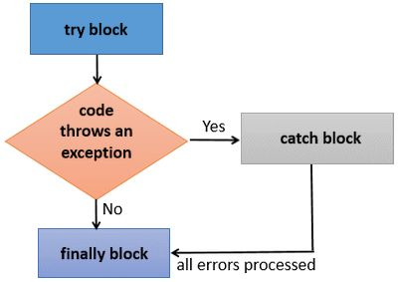
Java finally block
Java finally block is a block that is used to execute important code such as closing connection, stream etc.
Java finally block is always executed whether exception is handled or not.
Java finally block follows try or catch block.

Slide 104
Usage of Java finally
finally block execute when…
Exception doesn't occur.
Exception occurs and not handled.
Exception occurs and handled.

Slide 105
Case 1: Java finally example where exception doesn't occur
class TestFinallyBlock{
public static void main(String args[])
{
try{
int data=25/5;
System.out.println(data);
}
catch(NullPointerException e)
{
System.out.println(e);
}
finally
{
System.out.println("finally block is always executed");
}
System.out.println("rest of the code...");
}
}
Output:5
finally block is always executed
rest of the code...

Slide 106
Case 2: Java finally example where exception occurs and not handled.
class TestFinallyBlock1{
public static void main(String args[]){
try{
int data=25/0;
System.out.println(data);
}
catch(NullPointerException e)
{
System.out.println(e);
}
finally
{
System.out.println("finally block is always executed");
}
System.out.println("rest of the code...");
}
}
Output:finally block is always executed
Exception in thread main java.lang.ArithmeticException:/ by zero

Slide 107
Case 3: Java finally example where exception occurs and handled.
public class TestFinallyBlock2{
public static void main(String args[]){
try{
int data=25/0;
System.out.println(data);
}
catch(ArithmeticException e){
System.out.println(e);
}
finally
{
System.out.println("finally block is always executed");
}
System.out.println("rest of the code...");
}
}
Output:Exception in thread main java.lang.ArithmeticException:/ by zero
finally block is always executed
rest of the code...

Slide 108
throws
Used for only Checked Exceptions.
It should be applied at Method level.

Slide 109
throws – Example1
public class Test {
public static void main(String[] args) throws InterruptedException
{
System.out.println("Test started");
System.out.println("Test is in progress");
Thread.sleep(3000); // InterruptedException
System.out.println("Test is completed");
System.out.println("Test is exited");
}
}

Slide 110
throws – Example2
public class Test {
public static void main(String[] args) throws IOException
{
FileReader fr = new FileReader("C:\\Test.txt"); //FileNotException
BufferedReader bfr = new BufferedReader(fr);
System.out.println(bfr.readLine()); //IOException
}
}

Slide 111
 | Un-Checked | Checked | Method Level | Within the method
Try..Catch | Y | Y | N | Y
throws | N | Y | Y | N

Slide 112
Agenda
ArrayList
HashMap
JDBC

Slide 113
ArrayList
ArrayList is pre defined class in Java used for dynamic array for storing elements.
ArrayList can contains duplicate elements.
We can add, insert and remove elements from ArrayList.
Syntax:
ArrayList al=new ArrayList();
ArrayList<String> al=new ArrayList<String>();

Slide 114
Java ArrayList Example1
import java.util.ArrayList;
public class ArrayListExample {
public static void main(String[] args) {
ArrayList<String> list = new ArrayList<String>();
// adding elements to array list
list.add("Raj");
list.add("Ravi");
list.add("Pavan");
list.add("Simran");
list.add("Arvinder");
System.out.println(list.size()); // returns number of elements in array list
for (String s : list) // reading elements from array list
{
System.out.println(s);
}
}
}

Slide 115
Java ArrayList Example2
import java.util.ArrayList;
public class ArrayListExample2 {
public static void main(String[] args) {
ArrayList al = new ArrayList();
// adding elements to array list
System.out.println("number of elements" + al.size()); // Number of elements present in al
al.add("welcome");
al.add(10);
al.add(10.456);
al.add('C');
// Number of elements present in al
System.out.println("number of elements in array list after adding are:" + al.size());
System.out.println("elements in array list:" + al);
// inserting elements into array list
al.add(2, "training"); // 2 is describes after number of elements not position
System.out.println("elements in array list:" + al);
al.add(4, 1234); // 4 is describes after number of elements not position
System.out.println("number of elements in array list after inserting are:" + al.size());
System.out.println("elements in array list:" + al);
// Removing elements from array list
al.remove("welcome"); // Directly specify the value
System.out.println("elements in array list:" + al);
al.remove(2); // 2 describes after number of elements not exactly position
System.out.println("elements in array list:" + al);
}
}

Slide 116
HashMap
The important points about Java HashMap class are:
A HashMap contains values based on the key.
It contains only unique elements.
It maintains no order.

Slide 117
Java HashMap Example
import java.util.HashMap;
import java.util.Map;
public class HashMapExample {
public static void main(String[] args) {
HashMap <Integer,String> hm=new HashMap<Integer,String>();
//Adding key pairs into hash map
hm.put(100,"raj");
hm.put(200,"rahul");
hm.put(300,"kiram");
System.out.println(hm);
for(Map.Entry m:hm.entrySet())
{
System.out.println(m.getKey()+" "+m.getValue());
}
hm.remove(300);
System.out.println(hm);
}
}

Slide 118
JDBC – Java Database Connectivity
Java JDBC is a java API to connect and execute query with the database.
JDBC API uses jdbc drivers to connect with the database.

Slide 119
Database and SQL
Database: stores the data in the tables.
SQL- a language used for communicate to the database.
DML : Data Manipulation Language
DDL : Data Definition Language
DCL : Data Control Language
TCL : Transaction Language
DML : Data Manipulation Language
Insert
update
delete
select ( DRL - Data Retrieval Language)

Slide 120
Database Components
Database Client
CLI
GUI
Database Server

Slide 121
4 Steps to connect to the database in java
Creating connection
Creating statement
Executing queries
Closing connection

Slide 122
JDBC Example1 (insert, update & delete)
import java.sql.Connection;
import java.sql.DriverManager;
import java.sql.SQLException;
import java.sql.Statement;
public class JDBCExample1 {
public static void main(String[] args) throws SQLException {
//step1 : create connection
Connection con=DriverManager.getConnection("jdbc:oracle:thin:@localhost:1521/pdborcl","hr","hr");
//step2 :create statement(query)
//String insertquery="insert into employee values(108,'saran','abc')";
//String updatequery="update employee set First_name='Raj' where Employee_id=106";
String deletequery="delete employee where Employee_id=108";
Statement stmt=con.createStatement();
//step3: Execute the statement
stmt.executeQuery(deletequery);
//step4 :close the connection
con.close();
System.out.println("program completed");
}

Slide 123
JDBC Example2 (select)
import java.sql.Connection;
import java.sql.DriverManager;
import java.sql.ResultSet;
import java.sql.SQLException;
import java.sql.Statement;
public class JDBCExample2 {
public static void main(String[] args) throws SQLException {
//step1 : create connection
Connection con=DriverManager.getConnection("jdbc:oracle:thin:@localhost:1521/pdborcl","hr","hr");
//step2 :create statement(query)
String selectquery="select employee_id,first_name,last_name From employees";
Statement stmt=con.createStatement();
//step3: Execute the statement
ResultSet rs=stmt.executeQuery(selectquery);
//step 4: reading the data from result set
while(rs.next()==true)
{
System.out.print(rs.getInt("employee_id")+" ");
System.out.print(rs.getString("FIRST_NAME")+" ");
System.out.print(rs.getString("LAST_NAME")+" ");
System.out.println();
}
//step4 :close
rs.close();
con.close();
System.out.println("program completed"); } }

